Slide 1
INDIA’S AGRICULTURE CROP PRODUCTION ANALYSIS
Gajalakshmi. MB
Faculty mentor

Slide 2
Team Members
GOPIKA R
VIDHYA P
MONISHA R
GAYATHRI K
ASHA S

Slide 3
Introduction
This report delves into the captivating realm of India's agricultural cultivation, providing a comprehensive visual exploration of keyaspects and trends in the agricultural sector.
These visualizations enable intuitive analysis, allowing stakeholders to uncover patterns, identify areas of growth or concern, and make data-driven decisions.
By harnessing the power of Tableau, this report not only presents the data in a visually appealing manner but also provides an interactive experience for readers to explore the intricacies of India's agricultural cultivation

Slide 4
purpose
High Performance: Users rate Tableau's overall performance as strong and secure. ...
Mobile-friendly: ...
Extensive Customer Resources: ...
Excellent Mobile Support: ...
Easy to Upgrade: ...
Low Cost: ...
Quality Customer Service: ...
Ease of Use:

Slide 5
ADVANTAGES
DISADVANTAGE
Quickly Create Interactive visualizations:
Data visualization
Ease of Implementation:
Tableau can handle large amounts of data
Use of other scripting languages in Tableau
Use of other scripting languages in Tableau
No Custom Visual Imports
Custom formatting in Tableau
Static and single value parameters

Slide 6
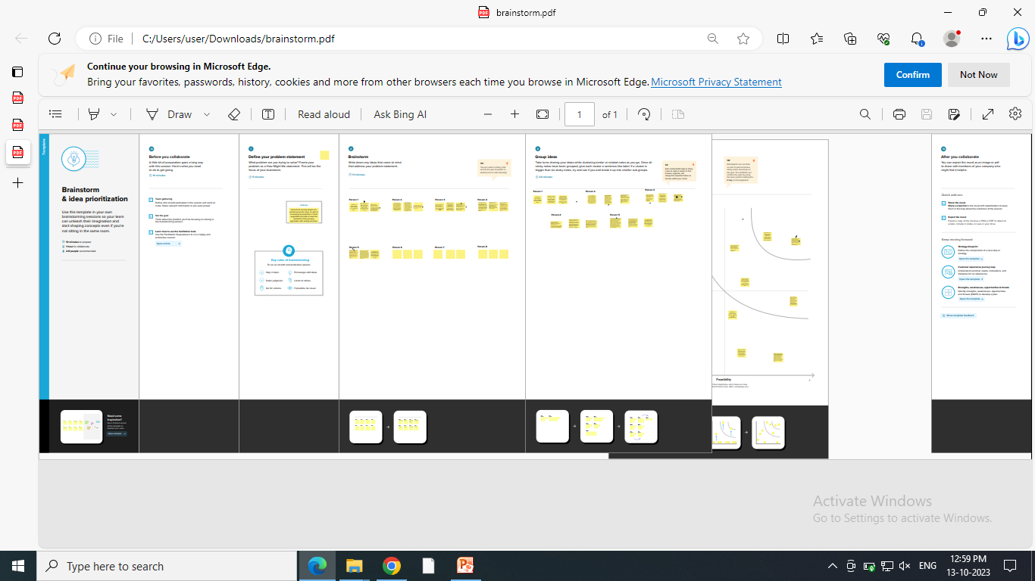
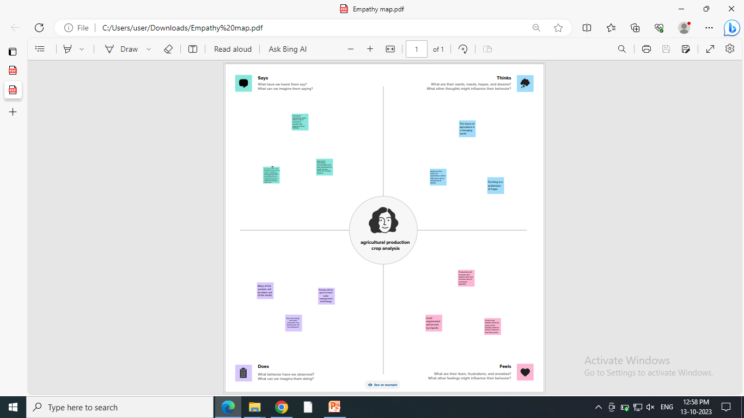
Brain storm and Empathy map

Slide 7
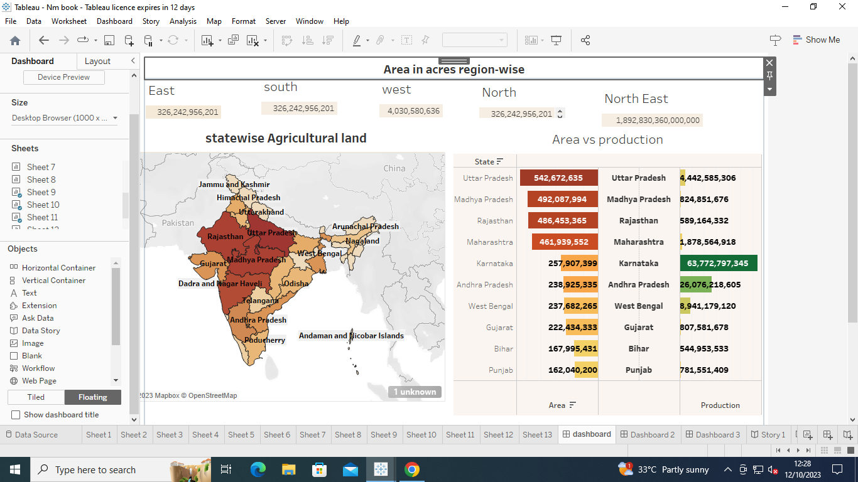
Dashboard 1

Slide 8
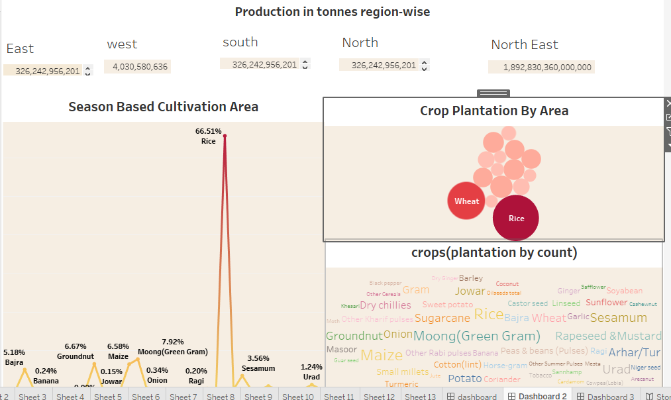
Dashboard 2

Slide 9
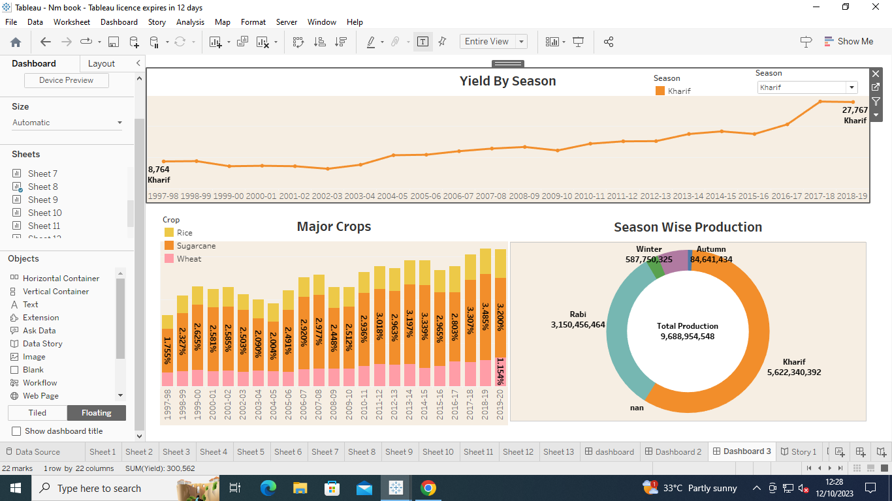
Dashboard 3

Slide 10
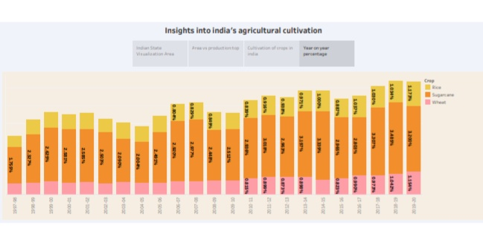
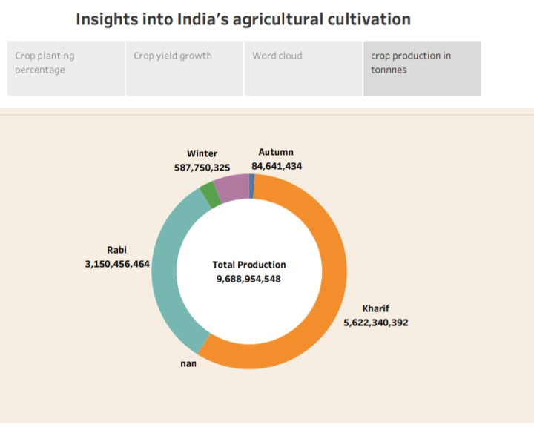
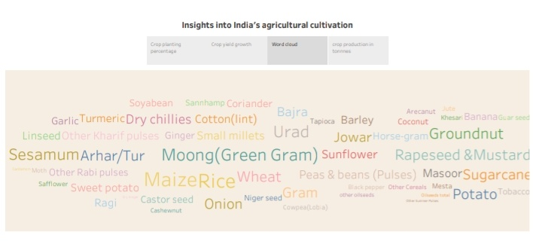
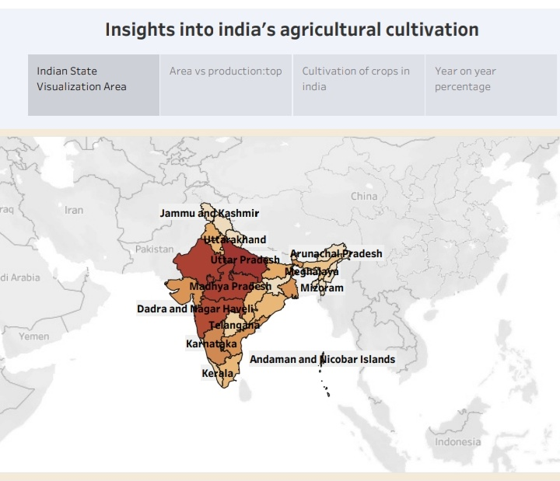
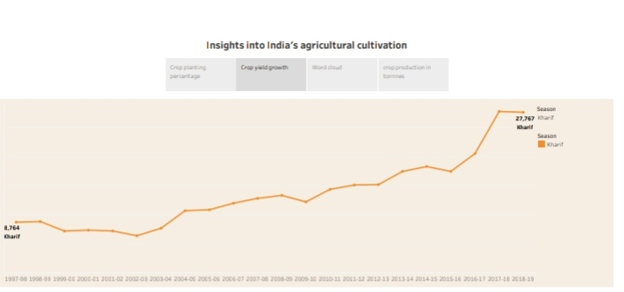
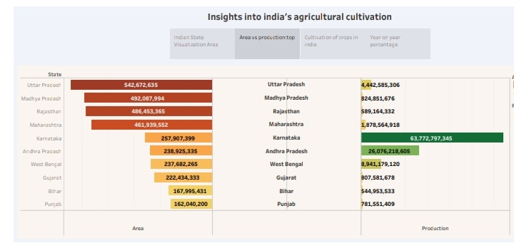
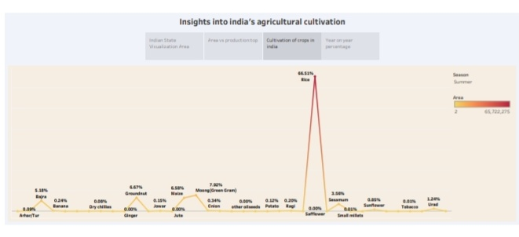
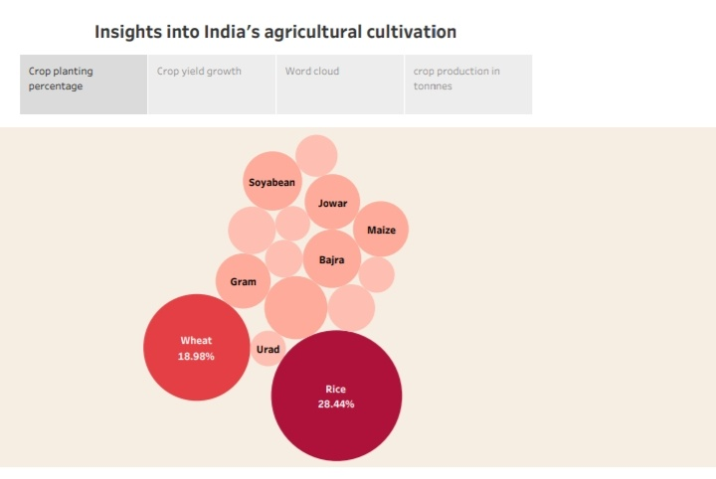
Story

Slide 11
Future scope
A person with knowledge of Tableau can get many roles like data analyst, business analyst, and Tableau consultant.
Further, in Business Intelligence, one can get roles like Business Intelligence Analyst, Business Intelligence Developer, and Business Intelligence Manager, all of which are highly paying roles.
Once you become a certified professional in Tableau from a reputable institute, your options are endless. Unlike few other programming languages that give you limited scope, this one has incredible scope and opportunities.

Slide 12
Conclusion
Though the dataset is complex or the dataset is very big, in tableau, we can create dashboards very easily and within less time.
Tableau is a visual analytics platform transforming the way we use data to solve problems—empowering people and organizations to make the most of their data
Tableau Desktop helps to create reports, dashboards, and stories using different charts and graphs

